Slide 1
Community Transformation Strategies
Arlington Housing Summit 2021
Dominic Cloud, City Manager
St. Albans, VT

Slide 3
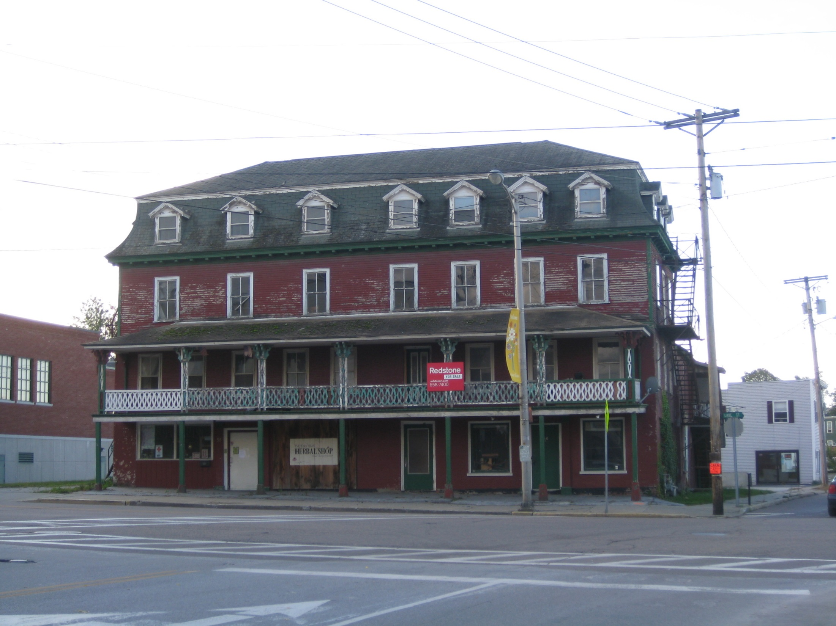

Slide 4
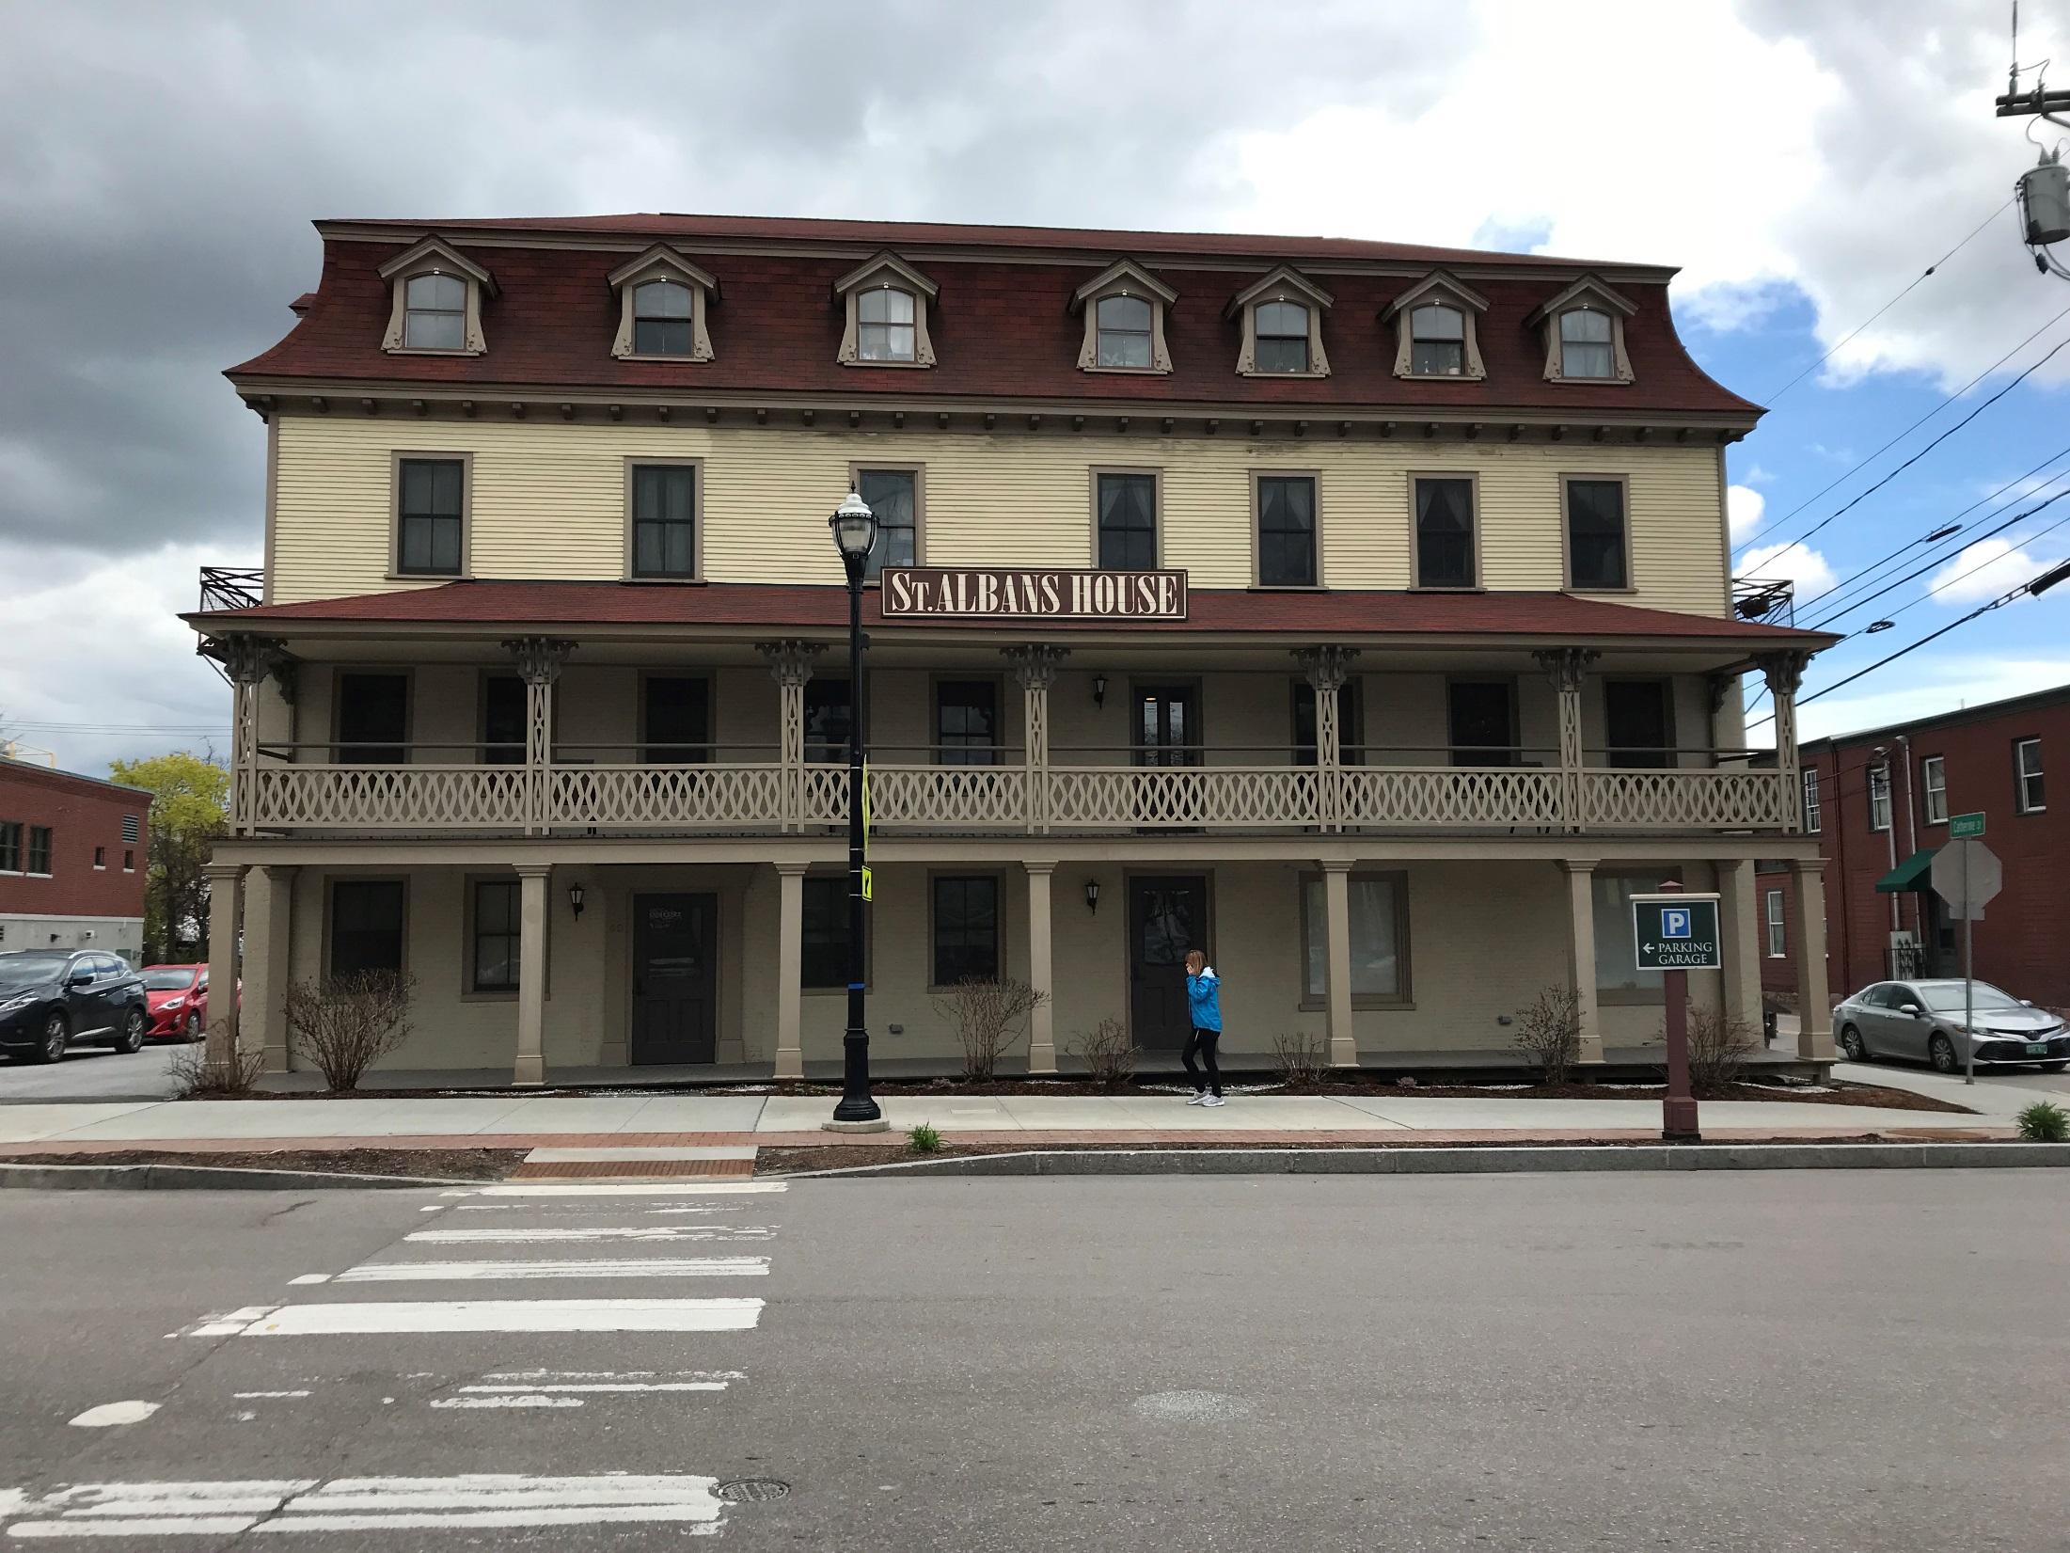

Slide 5
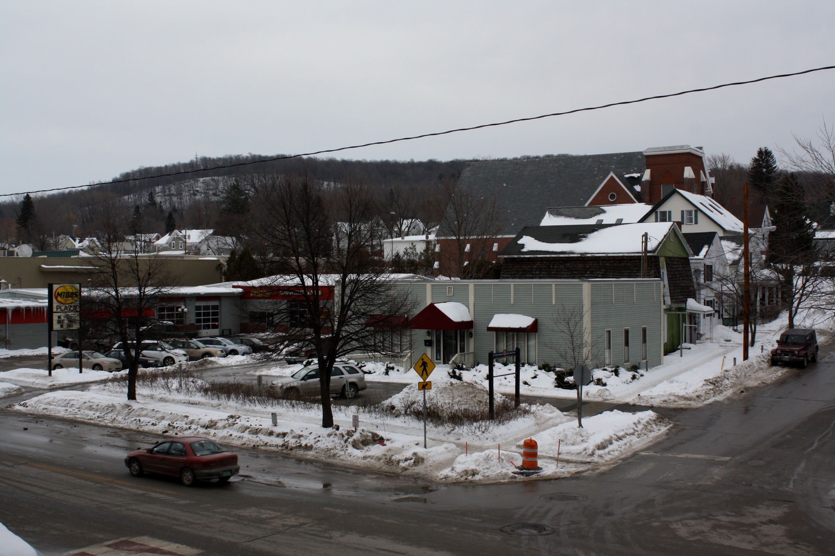

Slide 7
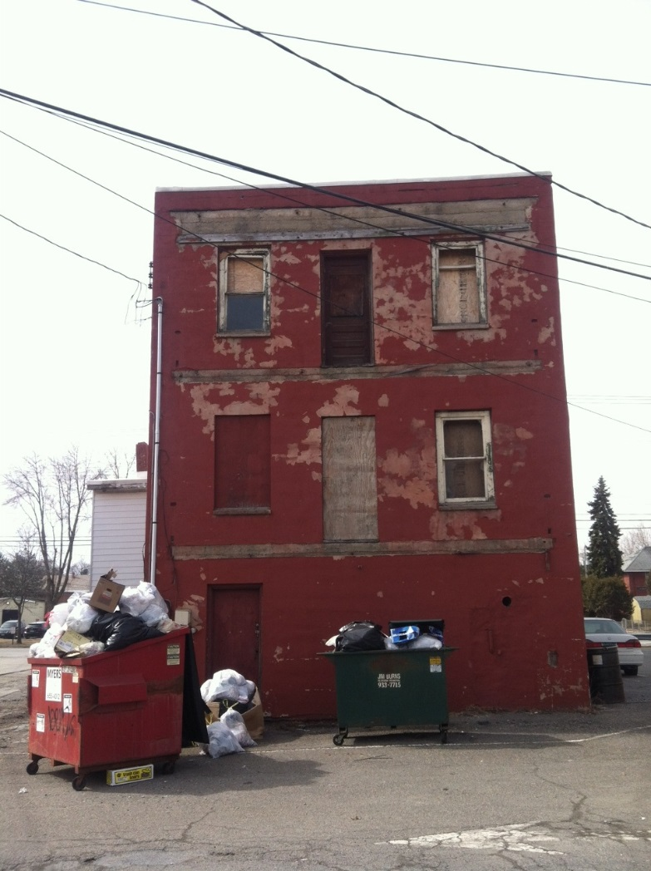

Slide 8
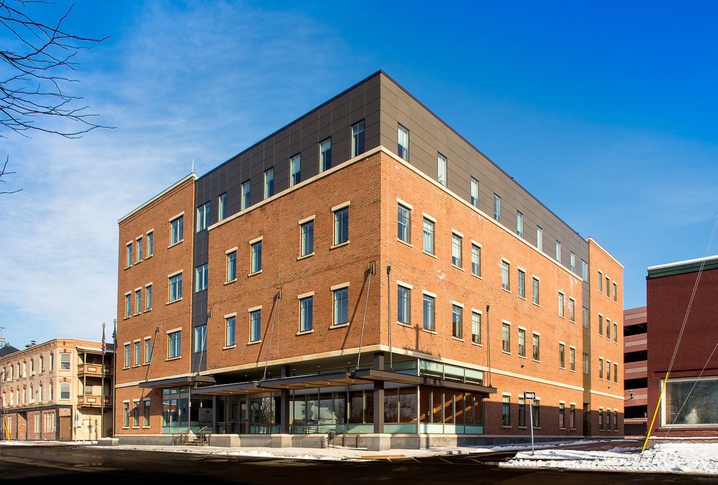

Slide 9
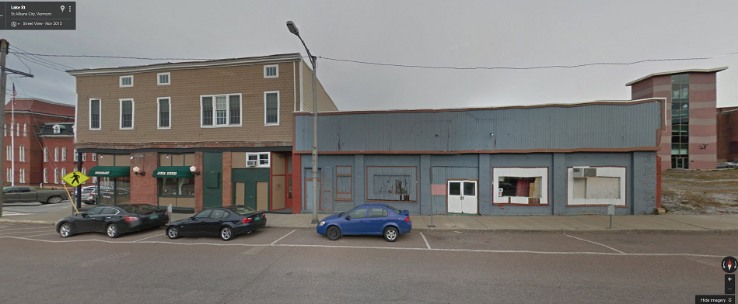

Slide 13
Snapshot: 7, 7, 10

Slide 14
Lessons
The development our community envisions will require public investment….
Public investment produces public control …
Our strengths (capital, return, risk) have real value in development context …
Community vitality evaluated by condition of both public and private properties
Willingness to utilize our strengths can produce superior results in shorter amount of time
Returns enjoyed for long time horizon

Slide 15
Principles
Economic development can be a municipal function.
Direct participation in the development process can make marginal projects viable.
Return on investment can be evaluated both qualitatively and quantitively, and over decades.

Slide 16
Practices
Site acquisition: buy the parcel, clean the parcel, transfer the parcel for the desired use.
Close financial gaps: equity contributions, rent guarantees, façade grants, direct lending, “sweeping.”
Provide and manage parking to encourage denser development and maximize site.
Scale it up to overcome hurdles.

Slide 17
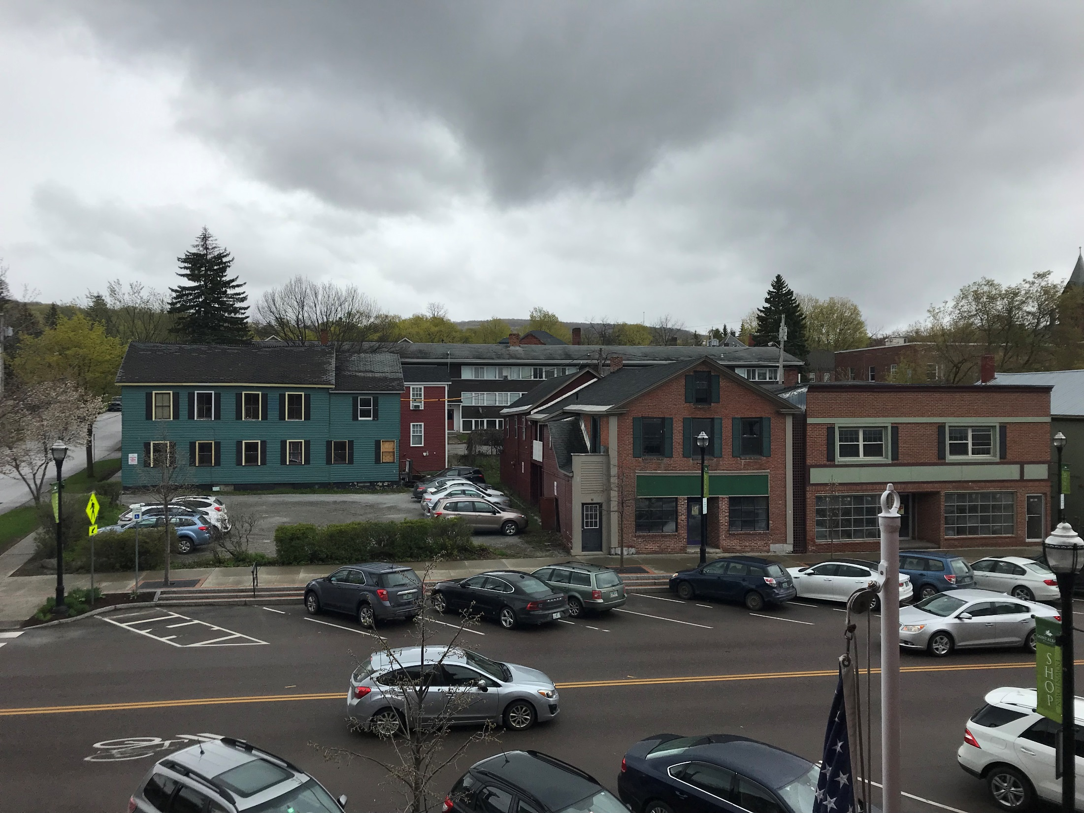

Slide 18
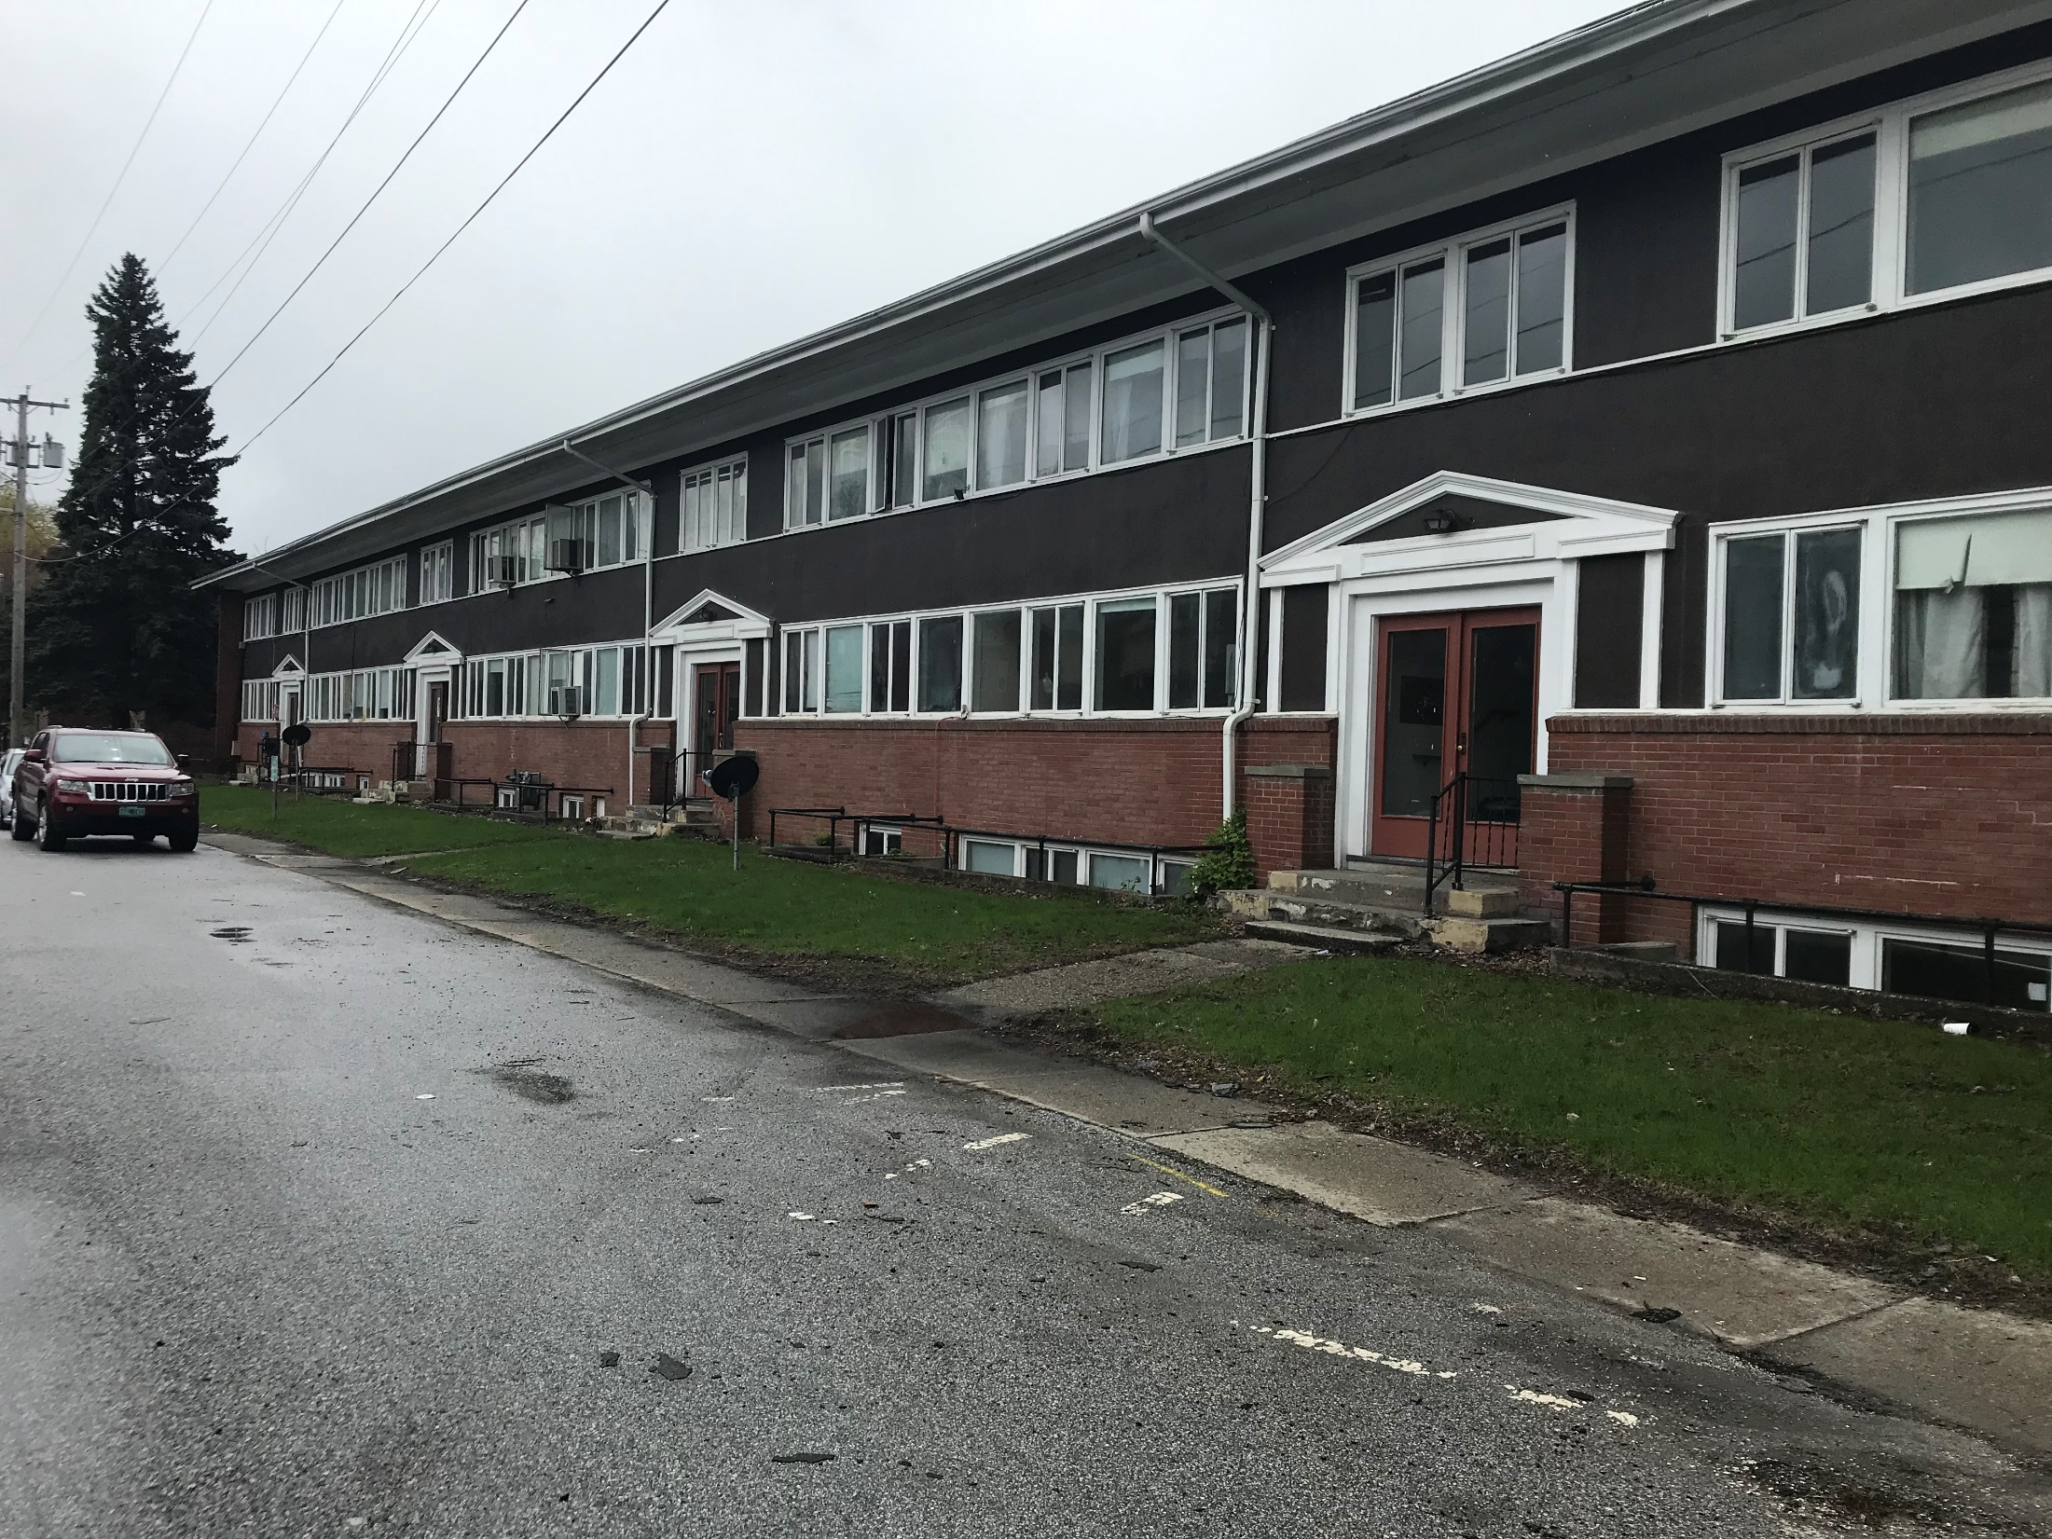

Slide 19
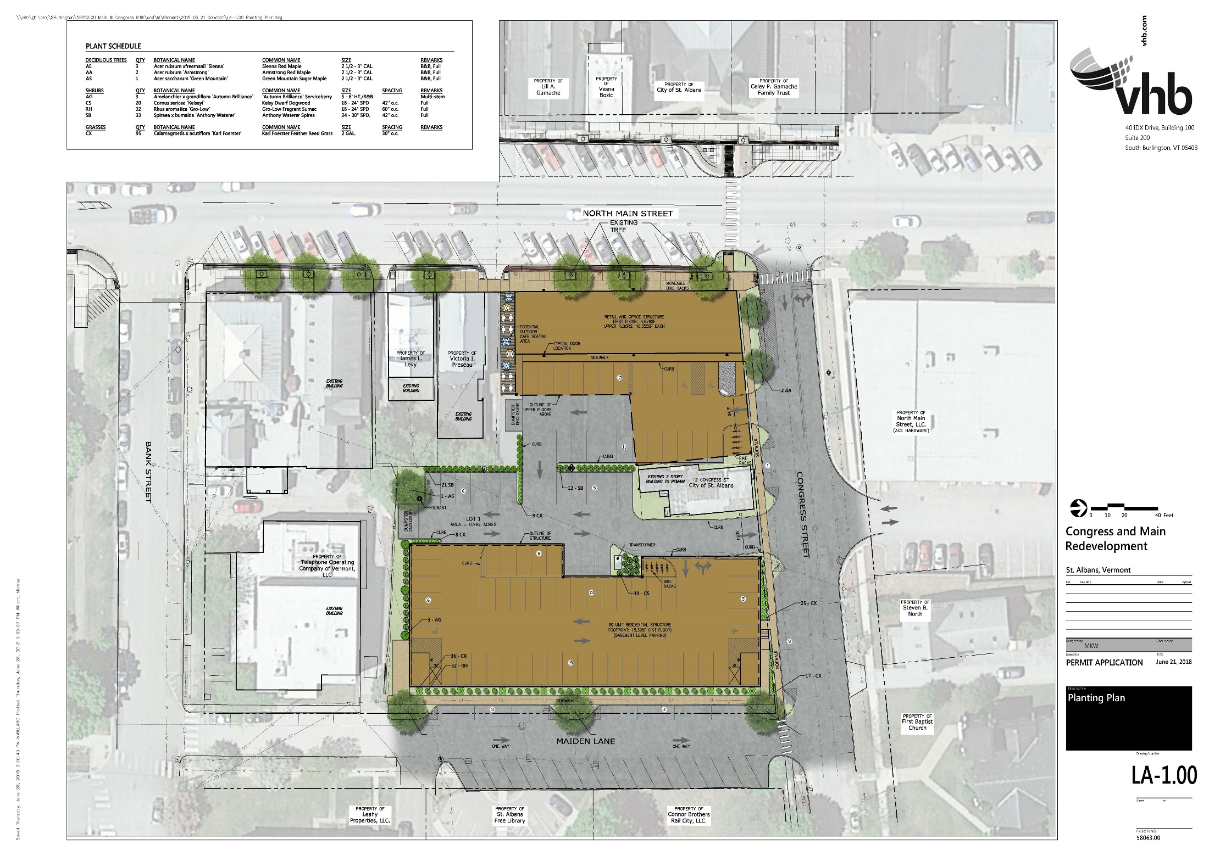

Slide 22
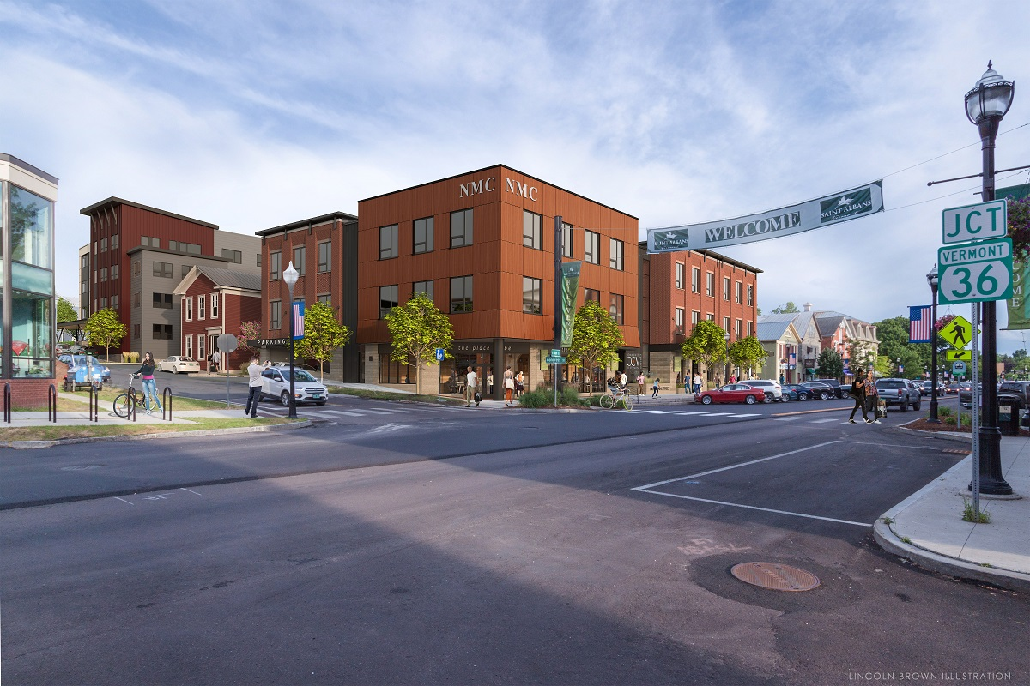

Slide 24
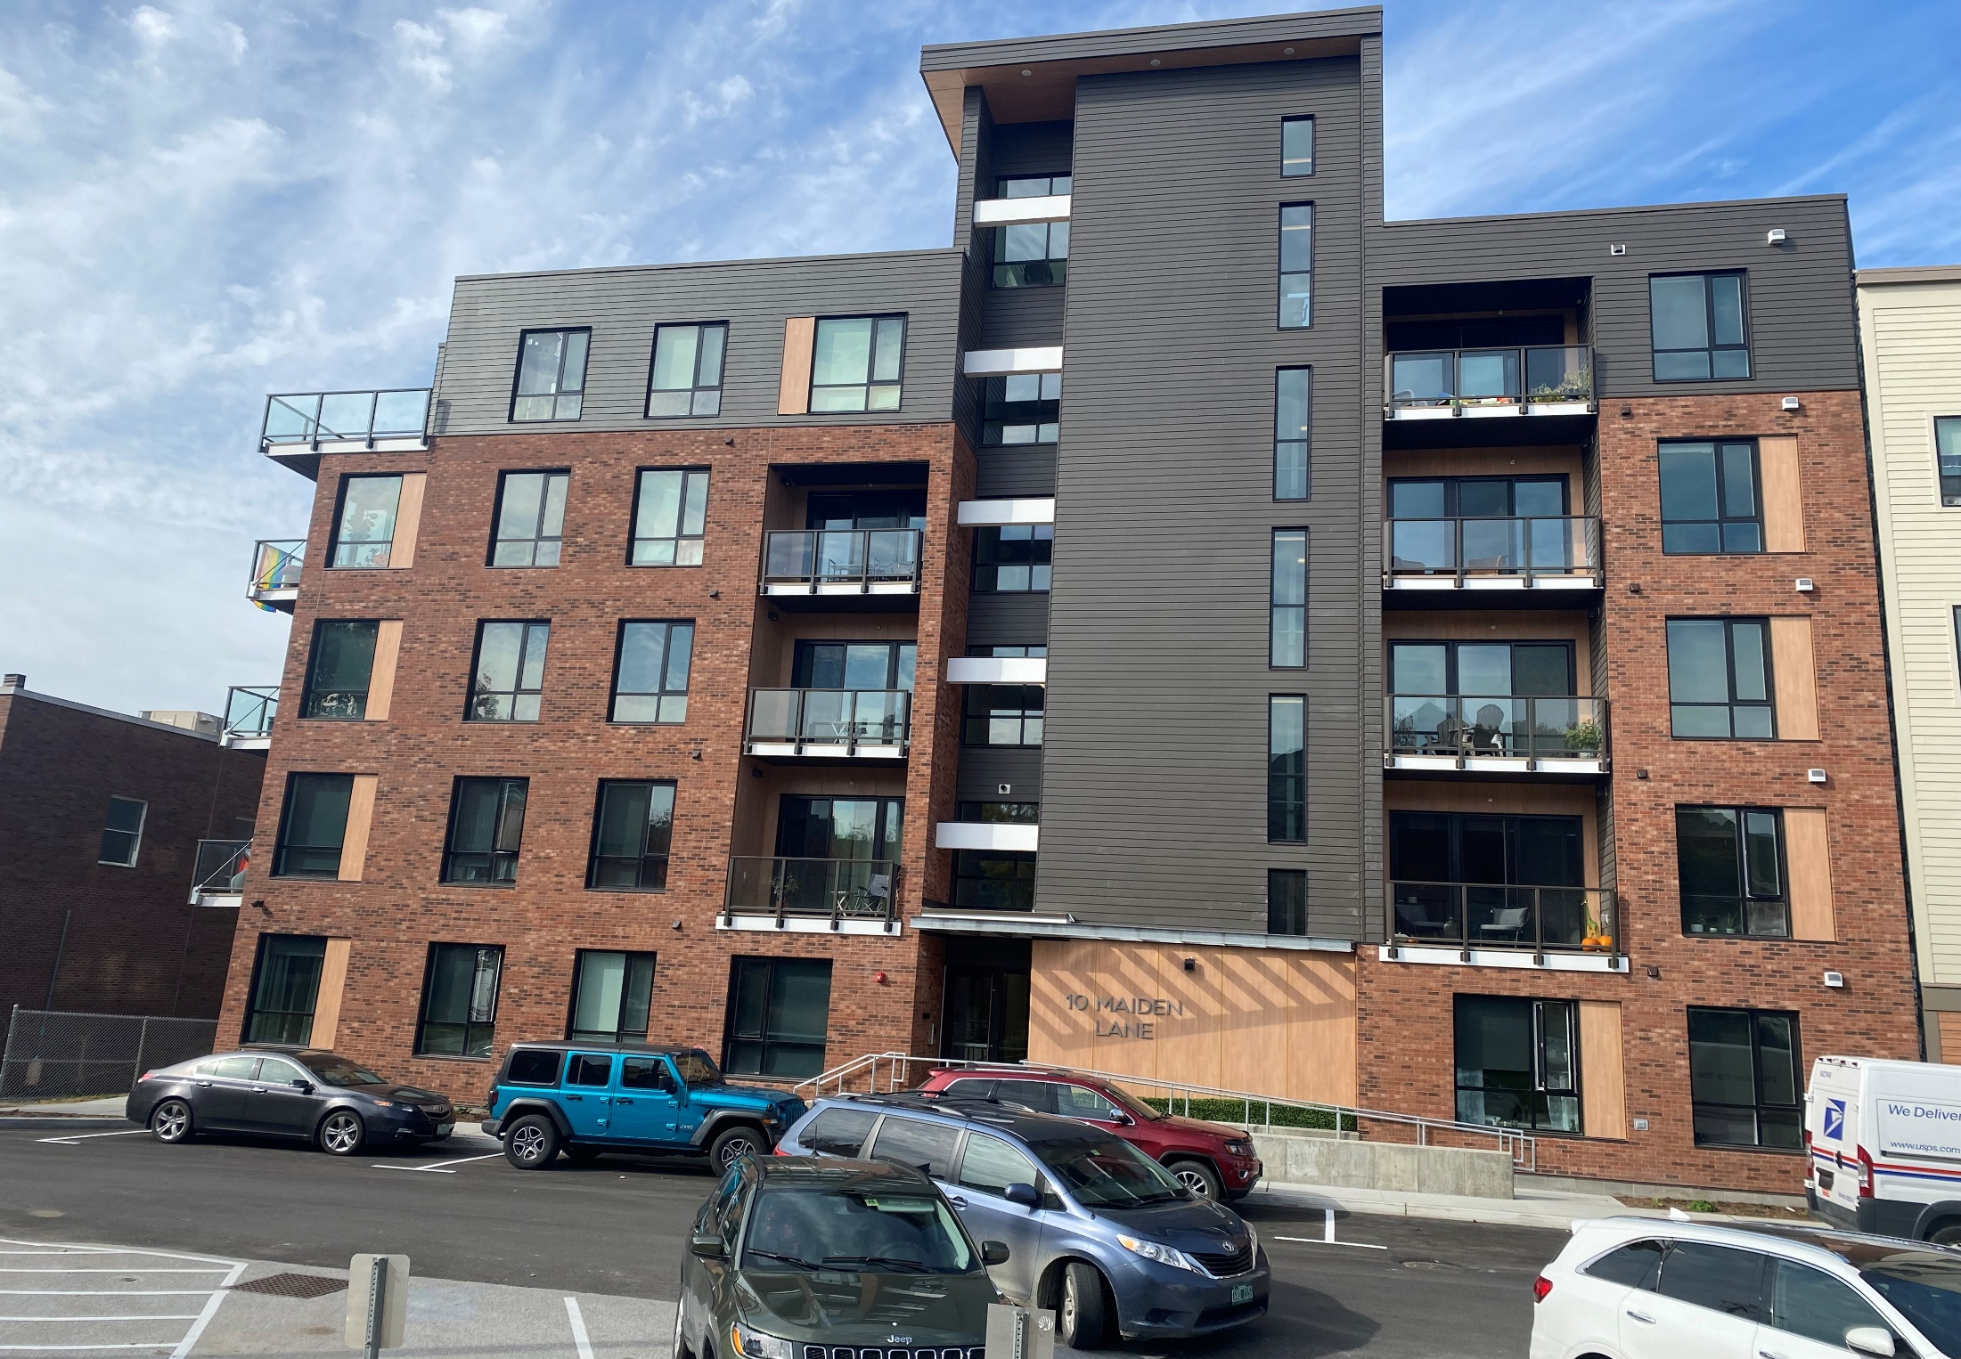

Slide 25
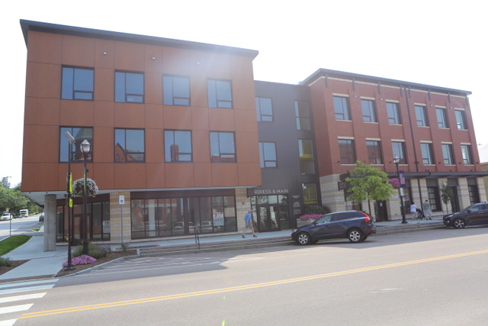

Slide 26
Congress and Main Deal Overview
City: acquire, clean, and transfer land; build and operate parking.
City contribute about $5 million for land acquisition, cleanup, and parking construction.
25,000 sf commercial; 30 units of affordable housing; 33 units of workforce housing
Tax base increased by $10 million and 60 units of new housing.

Slide 27
Concluding Thoughts …
Municipalities can lead their redevelopment by participating in the marketplace.
Municipalities can take risks and absorb costs that others cannot.
Confluence of historic interest rates, ARPA funds (direct and indirect), and infrastructure spending creates unparalleled opportunity.
If not now, when?

